Slide 1

MyFlix^{(not TM)}
Matt Gawlik
Todd Dale
Zach Hathaway

Slide 2

Outline
MyFlix description
Implementation
Demo
Evaluation
Conclusion

Slide 3

MyFlix description
MyFlix, a place for your movie tracking needs!
Track your favorite movies!
Search for movies in your favorite Genre!
See director, actors, country of production and more for your movies of choice!

Slide 4

MyFlix description
Benefits of using a database in this domain
Size and scalability
Save Space
Backups and Redundancy
Concurrency Control
Notes:
Size and scalability - We’re dealing with 1000s of records of data, with the potential to grow beyond what a front end application could handle.
Save Space - The data has relations such that an object oriented approach would be very inefficient.
Backups and Redundancy - A separate database allows easier backups, potential for redundancy,
Concurrency Control - More built in options for concurrency control.

Slide 5

Implementation
MySQL back end
C# .NET front end with jQuery and AJAX
Loaded the movie dataset from HetRec
Used MySQL Workbench’s Data Import Wizard
Imported into holding tables at first
Reformatted and inserted into our final table design
Generated integer ID to be keys for several tables

Slide 6

Implementation
Database consists of
15 Tables
29 Stored Procedures
8 core tables, 7 tables defining relationships. Relationship examples:
Many to one: Movies to Director
Many to many: Movies to Actors
Database Volume
~10,000 movies tracked
~95,000 actors
~13,000 movie tags
Only 20 genres
Notes:
Includes a users table.

Slide 7
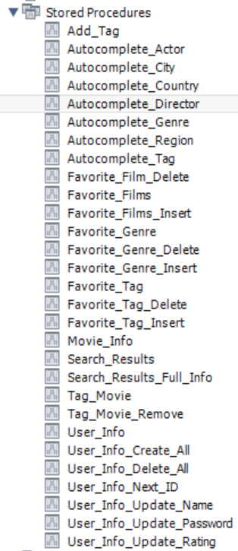

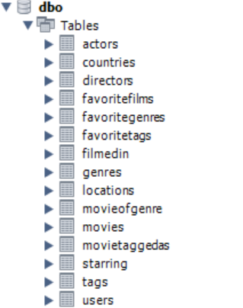
Implementation

Slide 8
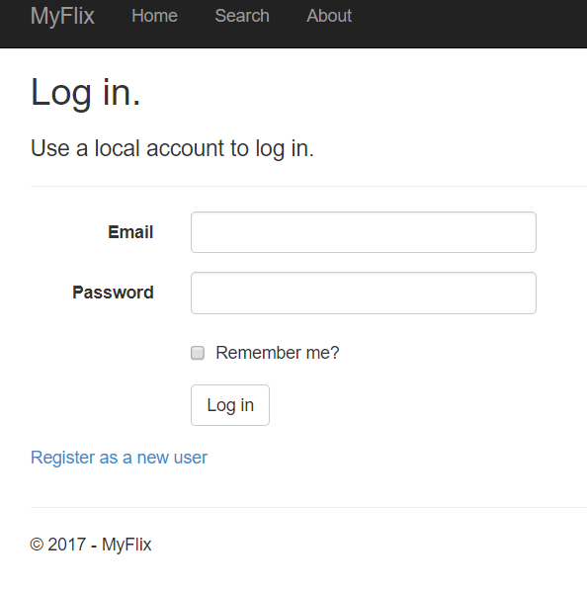

Slide 9
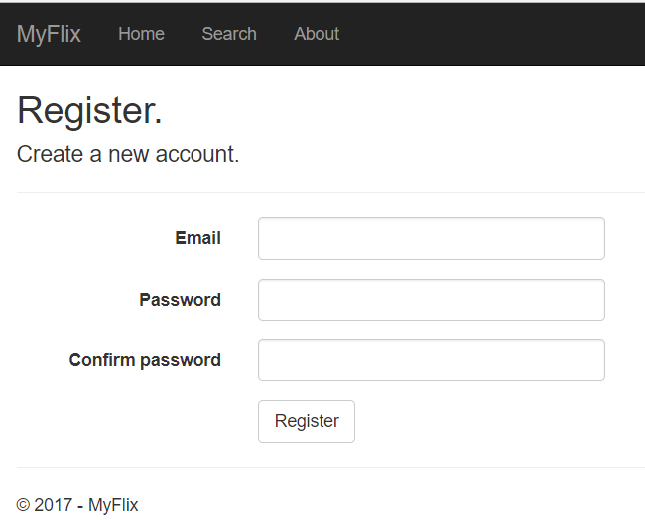

Slide 10
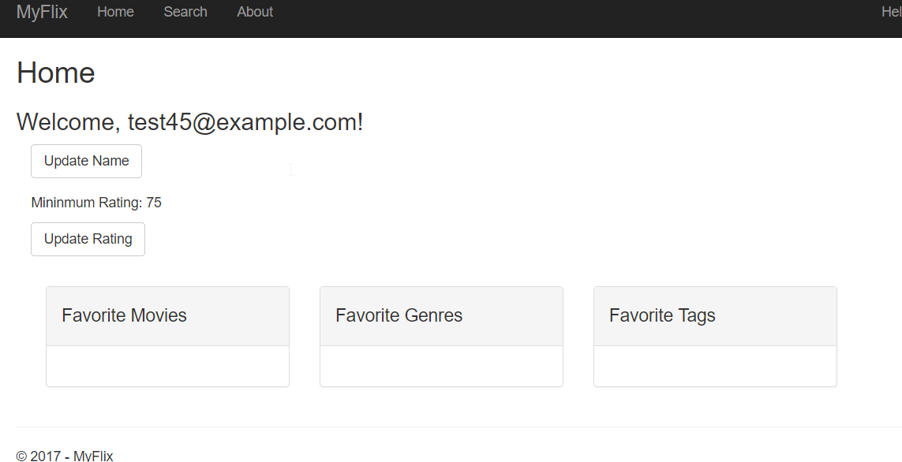

Slide 11
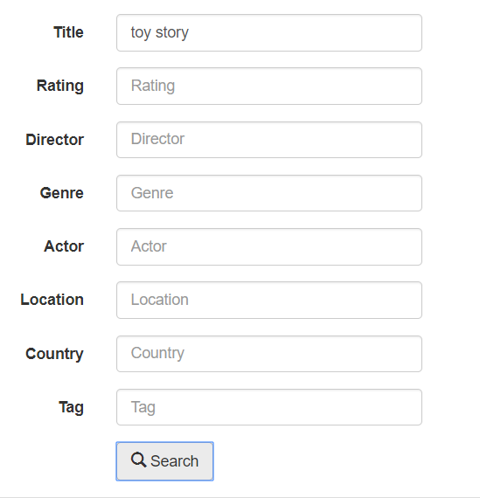

Slide 12
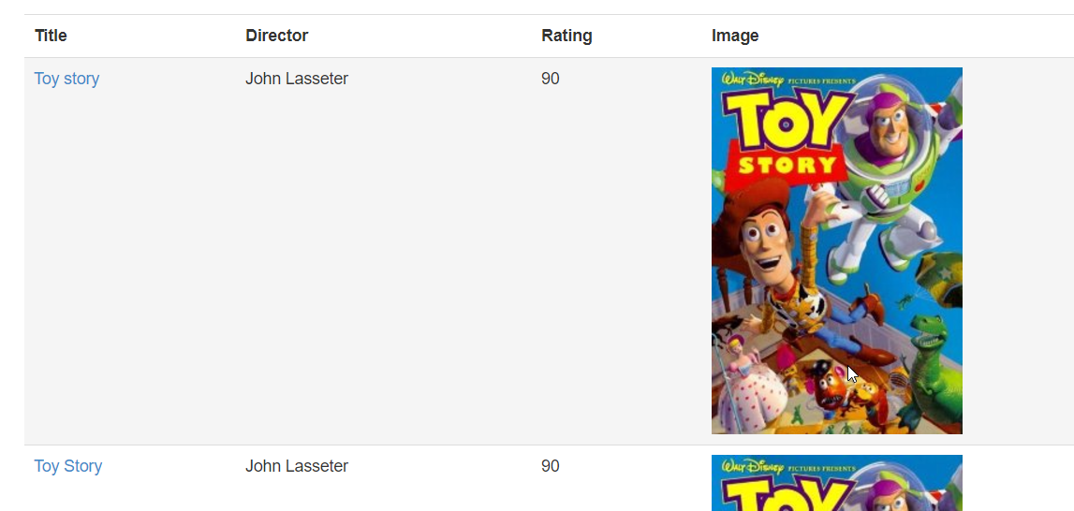

Slide 13
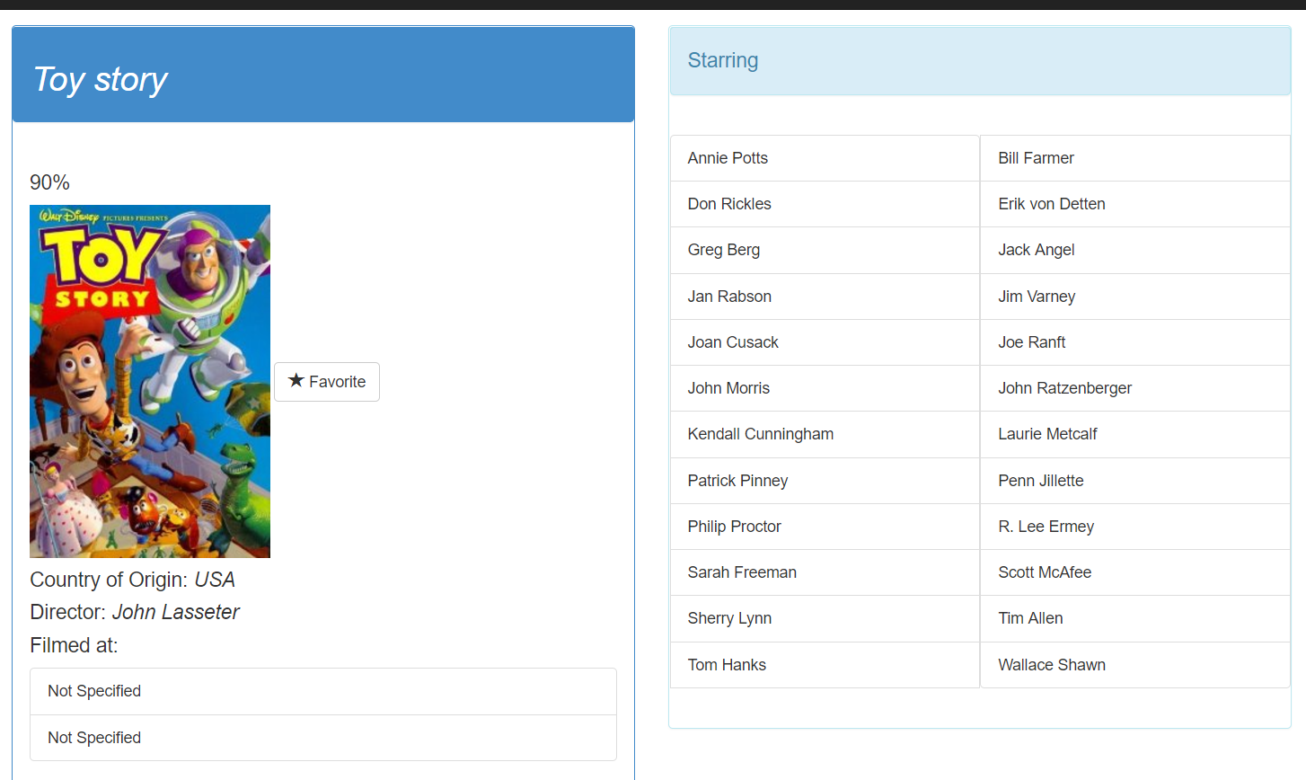

Slide 14
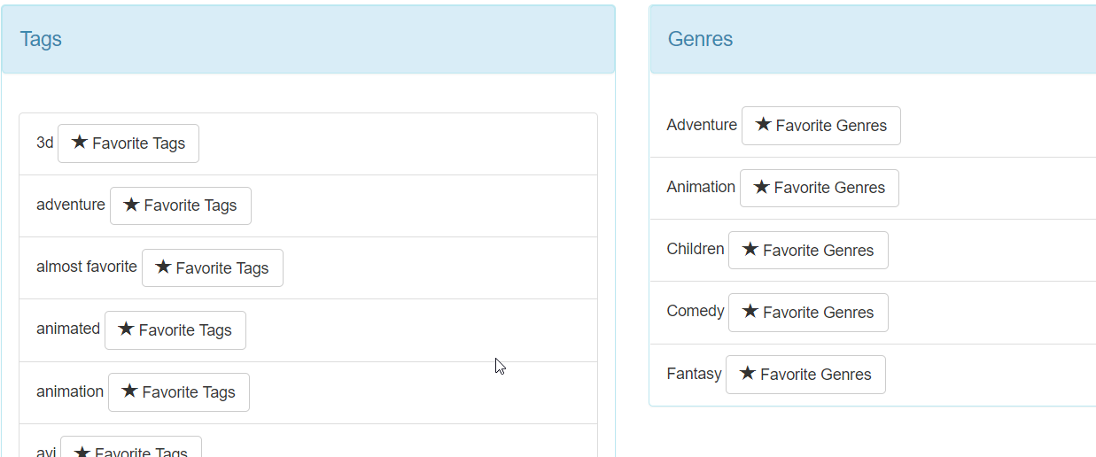

Slide 15

Demo

Slide 16

Statistics
The average rating of movies appears to be 5.04, which is about what you’d expect
Top 5 actors and number of movies they starred in:
Actor | Movies starred in
Samuel L. Jackson | 72
Robert De Niro | 70
Steve Buscemi | 66
Christopher Walken | 64
Robert Duvall | 62

Slide 17

Evaluation
Search feature – As Expected
User suggestions based on preferences – Mostly works as expected. Would like more features.
Rate movies – Ended up not implementing this.
Did implement picking favorite movies
Would take a lot more data gathering to marry up existing rating data with any new rating data.

Slide 18

Lessons Learned
Format of your data is very important. Cleaning up your data can take time.
Discrete IDs for primary keys are helpful and easier to work with
Importance of a good code tracking system with trunks and branches (Git, SVN, etc.)
Large file sizes for databases can make this harder
Divide and conquer vs. everyone work on the same thing has pros and cons

Slide 19

Conclusion
Have a functional website to search for, track, and tag movies
Database made this much easier to implement and compartmentalize the logic used by the site

